Slide 1
CROP PRODUCTION ANALYSIS
B.DEVADHARSHINI
IFET COLLEGE OF ENGINEERING
‹#›

Slide 2


PROBLEM STATEMENT
The objective of this Power BI project is to analyze crop production data to identify trends and patterns, calculate crop yields, and assess resource utilization.
The analysis aims to provide actionable insights for improving agricultural practices, optimizing resource allocation, and enhancing crop management strategies to boost productivity and sustainability in farming.
‹#›

Slide 3
Project Description
Crop Production Analysis
Agriculture is the backbone of many economies, crucial for food security and sustainable development.
Crop production involves cultivating plants such as cereals, fruits, and vegetables for consumption and commercial purposes.
Efficient crop production ensures a stable food supply and supports the livelihoods of millions of farmers worldwide.
Detailed Description
This Power BI project analyzes crop production data from various states and districts in India over multiple years and seasons.
It aims to uncover trends, identify seasonal variations, calculate crop yields, and assess resource utilization.
The project provides data-driven insights and recommendations to enhance agricultural practices, optimize resource allocation, and improve crop management strategies.
The resulting reports and dashboards will support farmers, policymakers, and agricultural stakeholders in making informed decisions for more efficient and sustainable agricultural practices.
7/13/2024
Annual Review
‹#›

Slide 4

WHO ARE THE END USERS?
Farmers
Policymakers
Agricultural Researchers
Agricultural Consultants
7/13/2024
Annual Review
‹#›

Slide 5

Technology Used
Power BI: Data visualization and interactive dashboards.
Power Query: Data transformation and preparation.
DAX (Data Analysis Expressions): Complex calculations and enhanced analytics.
Excel: Initial data exploration and basic analysis.
7/13/2024
Annual Review
‹#›
Notes:
5

Slide 6
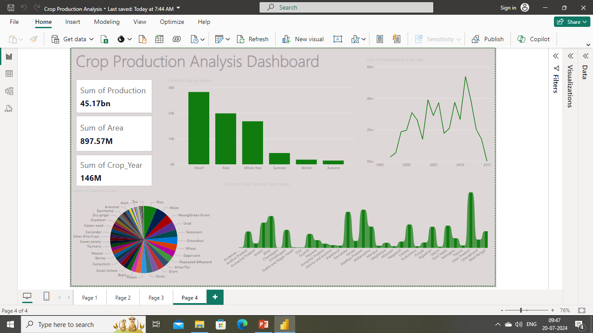
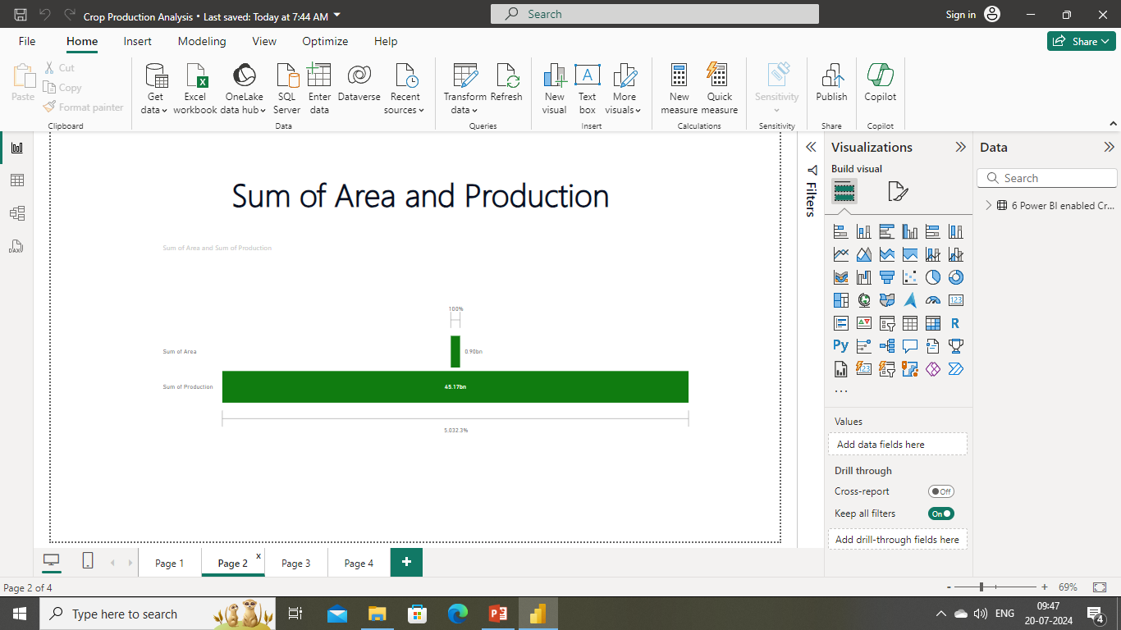
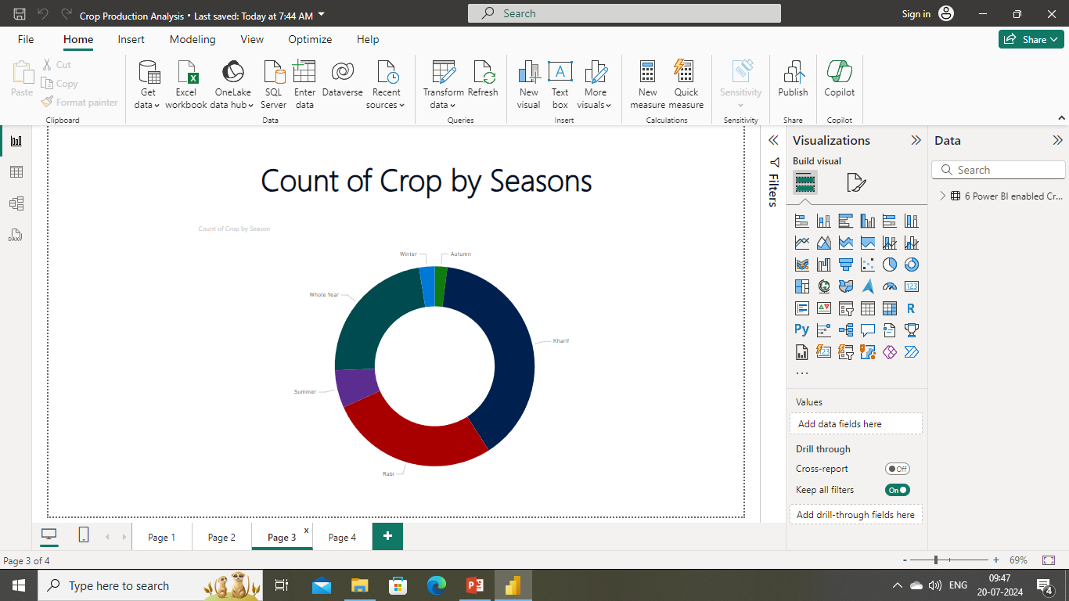
RESULTS
https://github.com/devadharshinibaskar/vois/blob/main/Crop%20Production%20Analysis.pbix
7/13/2024
‹#›

Slide 7
Thank you
.
.
‹#›

